Slide 1


Unit Testing - MyYear13
Jest is a delightful JavaScript Testing Framework with a focus on simplicity. It works with projects using: Babel, Typescript, Node, React, Angular, Vue and more!
Vue Test Utils is the official unit testing utility library for Vue.js. Providing comprehensive API to assert Vue (data, props, computed properties, methods, emit, Vuex…)
+
Notes:
- Jest is open source and maintained by Facebook
- Vue Test Utils: Vue team

Slide 2
Unit Testing - MyYear13
The three steps of Unit Testing:
arrange (set up for the test. In our case, we render the component).
act (execute actions on the system)
assert (ensure the actual result matches your expectations)

Slide 3
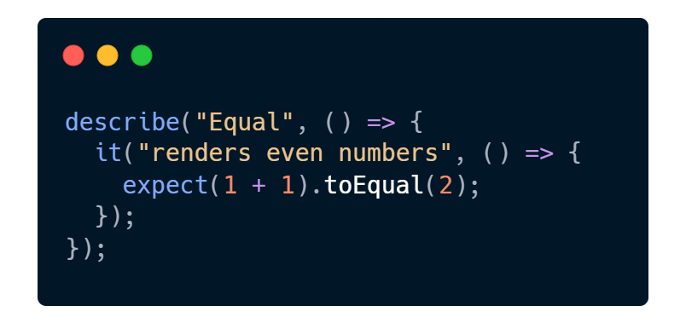

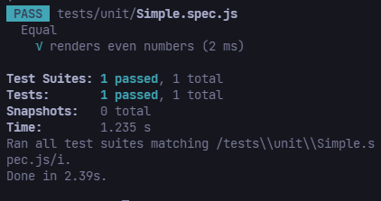
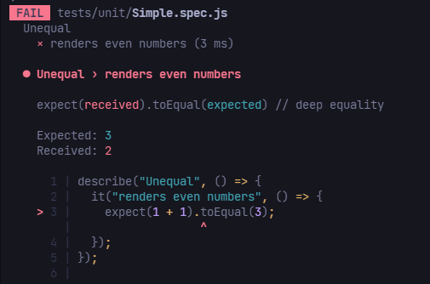


Test case - Result

Slide 4
Demo Flow
1. Set up a test case – Simple.spec.js
2. Rendering Components – Greeting.spec.js
3. Testing Props, Data – SubmitButton.spec.js
4. Computed Properties – NumberRenderer.spec.js
5. Simulating user input – FormSubmitter.spec.js
6. Testing emitted event – Emitter.spec.js
7. Mocking global objects – FormSubmitter.spec.js
8. Stubbing components - ParentWithAPICallChild.spec.js
9. Vuex – Feel free to explore yourself

Slide 5
References
Vue Test Utils’ Doc: https://v1.test-utils.vuejs.org/guides Rendering Components
Vue Testing Handbook: https://lmiller1990.github.io/vue-testing-handbook/
Vue School: https://vueschool.io/courses/learn-how-to-test-vuejs-components

Slide 6

Thank you!

